Slide 1


TWITTER WEB SERIES Data VISUALIZATION WITH SPARK ETL
TEAM MEMBERS
AVINASH GANGURI
AKHIL KANUGOLU
GEETANJALI MAKINENI
BHASHITHA SIDDAREDDY

Slide 2
INTRODUCTION
Twitter Data Analysis with Spark ETL and visualizing is our title. Here we are taking the Twitter’s Web series data. The main objective of our project is doing the ETL process using the Spark’s Batch Processing and then Spark Integration using Web UI. The main source of our data is twitter and then collecting the data with Spark Batch Process. We can perform our transactions on the set of RDD’s and later we load our data in our Hive which is similarly equal to the ETL basic process. This is because we are living in a world where data handling and data using plays one most important role in making the decisions for most of the industries

Slide 3
MOTIVATION
The motivation behind doing this analysis is we are living in a world where data handling and data using plays one most important role in making the decisions for most of the industries like Banking, Financial, Telecom and Health and IT sector serving ones. The main factors would be for getting the insights would be like managing its sheer volumes of data and its insights. Using the Apache Spark is one of the best amazing kind frameworks which will be handling big data and its real time performance of these analysis.

Slide 4

Idea
Instead of collecting from different data sources, we chose a single social media platform – Twitter where we feel users reviews are authentic than predictable. So we can analyse the list of trending web series where people desired to watch.

Slide 5
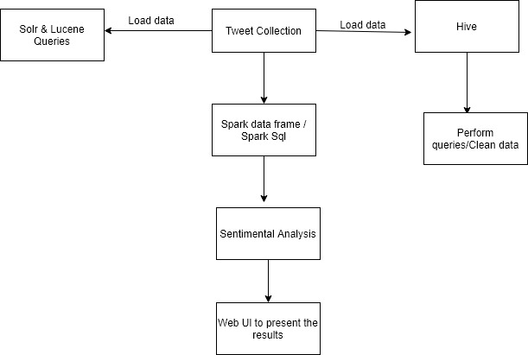
SIMPLE PROJECT FLOW

Slide 6
WORKFLOW
We have now first created one twitter developer account where next we got the tokens and credentials from API from where we took the twitter streaming and tweepy API in the python and stored tweets into the db. Extracted around 2.5 GB of dataset. Saved the data file in json format. Preprocess the data and create the database in spark framework with Scala programming. Will be creating a data frame and use the Sql Context to execute the SQL queries. In our next phases we are implementing it on Solrs and Lucene on our data and we also creating spark data frames on the file and creating different actions on data frames. We finally do the sentiment analysis on our data.

Slide 7
TOOLS & TECNOLOGIES
PYTHON
HIVE
HADOOP
SPARK
GRAPHFRAMES
DOCKER

Slide 8
OBJECTIVE
The main objective of our project is doing the ETL process using the Spark’s Batch Processing and then Spark Integration using Web UI. The main source of our data is twitter and then collecting the data with Spark Batch Process. We can perform our transactions on the set of RDD’s and later we load our data in our Hive which is similarly equal to the ETL basic process.

Slide 9
SIGNIFICANCE
Due to Quarantine and Isolation most of the people are looking for entertainment back in their homes by watching series, and to suggest trending based on the peoples genuine interest.

Slide 10
FEATURES
The main feature of the project is to collect the tweets from the twitter steaming API, also by performing the ETL which means we preprocess the data and extract the necessary data and then we load this data in our HIVE. Next, we use TextBlob for predicting the sentiment for each of the mentioned tweet. Later, we feed the data into our HDFS and then we implement SQL and Hive queries. Sqoop is used for transferring data between SQL and HDFS.

Slide 11
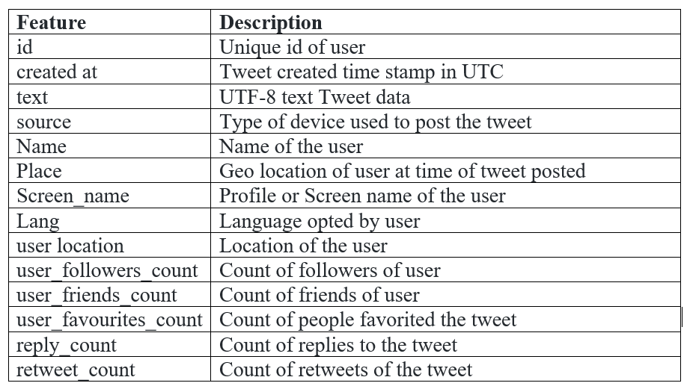
DATASET
We collect the data from Twitter with API with a developer account credentials. Here we took the keywords as Netflix, TV shows, etc., These tweets are in JSON file format. We have collected nearly like 2.5GB size. It has an information that shows like web series, tv series, documentary, Netflix shows, tv shows. We are collecting here using an API which is in batch format which is nearly downloading like around 5kb for a second where we filter the keywords like Netflix shows, TV shows etc.,

Slide 12
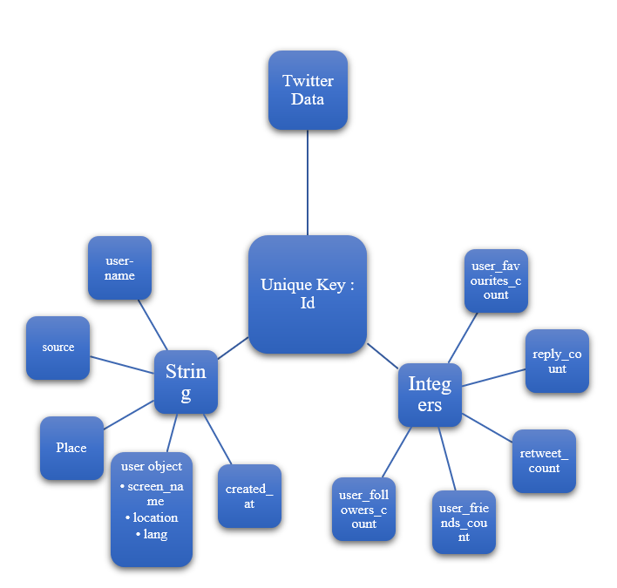
Analysis
We have now first created one twitter developer account where next we got the tokens and credentials from API from where we took the twitter streaming and tweepy API in the python and stored tweets into the db. Extracted around 2.5 GB of dataset. Saved the data file in json format. Preprocess the data and create the database in spark framework with scala programming. Will be creating a data frame and use the Sql Context to execute the SQL queries.
Figure: Design of Features/ Attributes

Slide 13
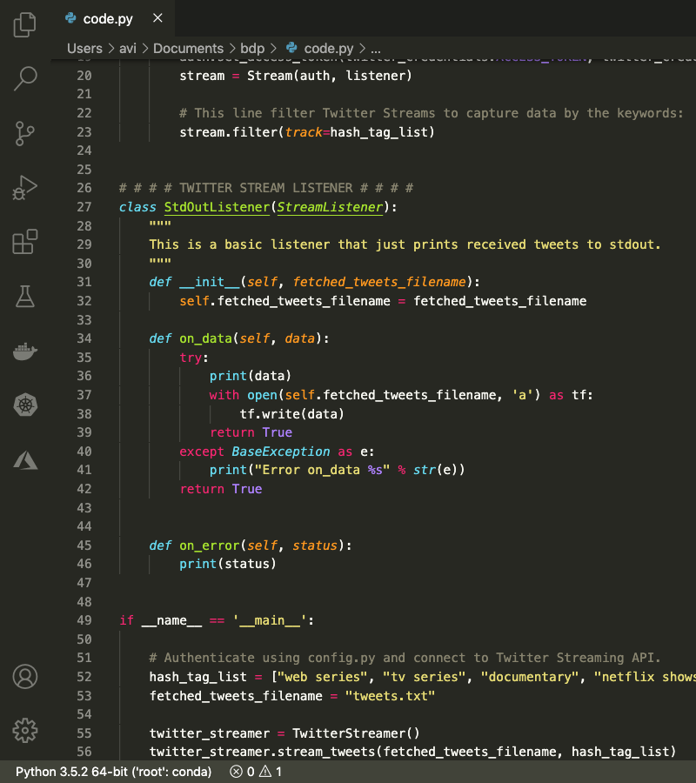
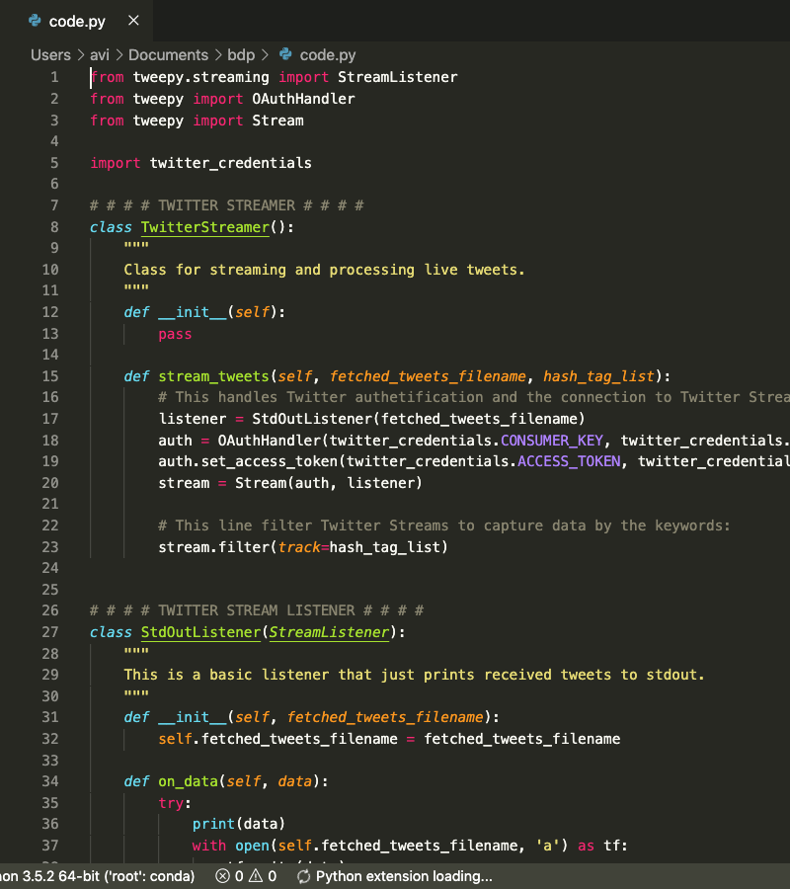
tWEETS EXTRACTION

Slide 14
Spark – scala ANALYSIS (phase 1)
Number of Tweets that are from different countries on web series
Different languages in which the tweets are made about web series
Fetching the users account names with a greater number of tweets on web series
Fetching the users that have more followers who are tweeting based on web series.
Fetching the number of tweets based on different web series.
Users with a greater number of retweets for their tweets on web series.
Fetching the top tweeted text and checking if someone retweeted it on web series.

Slide 15
SPARK – PYTHON ANALYSIS
Counted the number of tweets based on the place and arranged in descending order
Counted the no of tweets based on the sources of data
Counted the tweets by grouping into languages and order in descending order with pulling top 5.
Based on top5 maximum favourites_count of tweets by user_name
Pulling the count of tweets based on the desired series from the text attribute
Count of tweets for Netflix, Hulu, prime
Ordered the count of tweets of top 20 for the screen name

Slide 16
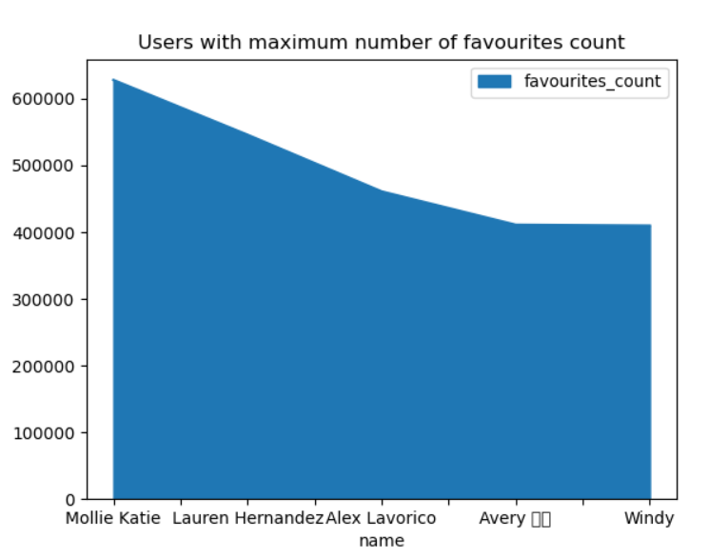
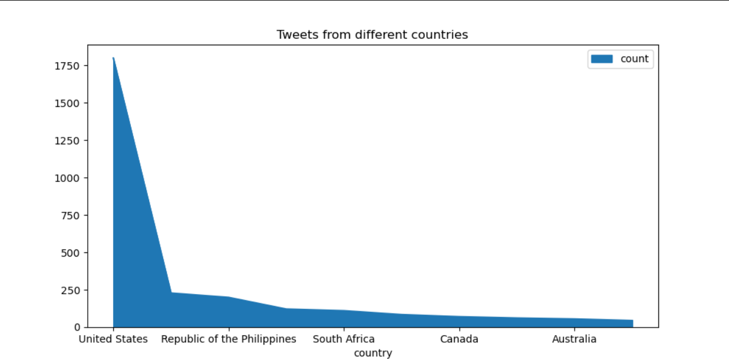
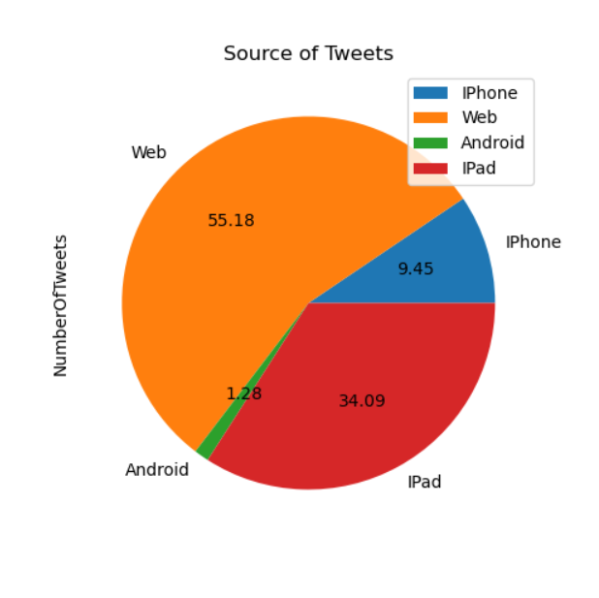
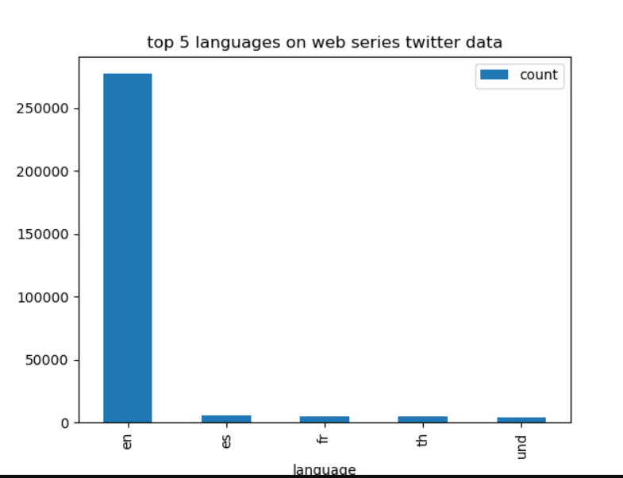
Visualizations

Slide 17
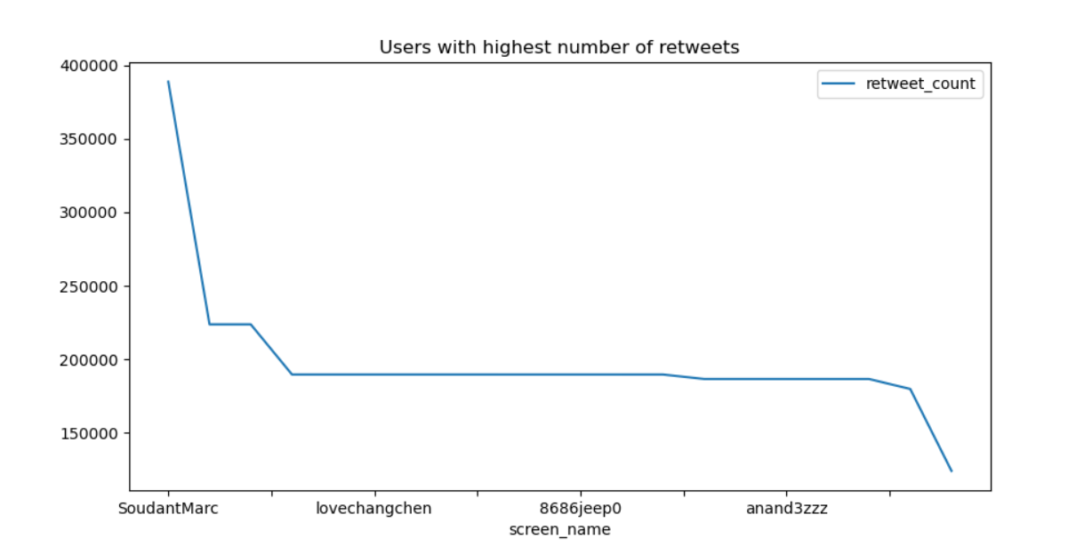
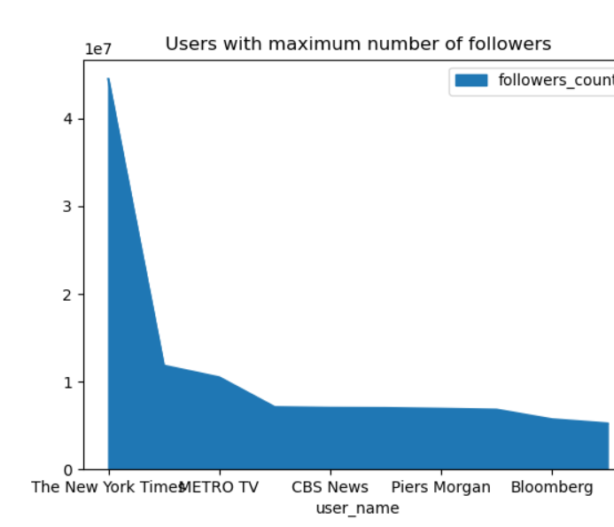
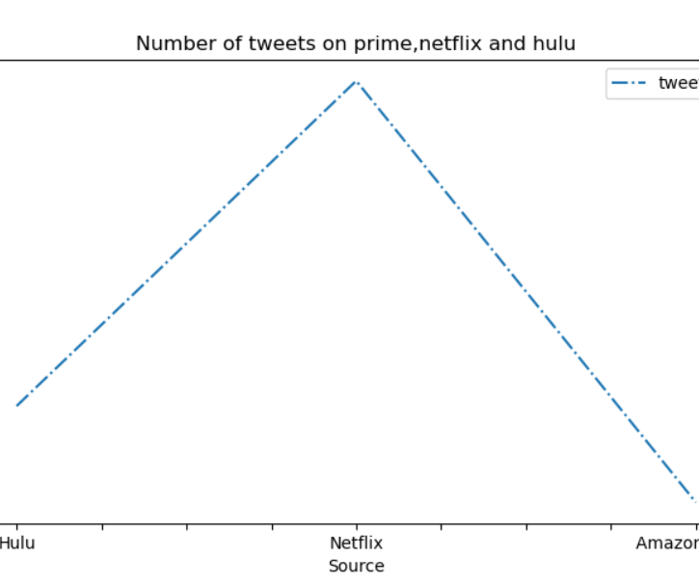

Slide 18
sOLR analysis
Pulled the 10 records of data in json form.
Pulled the data with user_location has USA (Regex)
Pulled the data has Netflix with in tweet (Regex)
Using fuzzy search of user_favourites greater than 7000 and text having hulu.
Collected the response with having text:”prime” and prime:”love”
Implemented Proximity query by pulling the data having user_name with prince with proximity 3.

Slide 19
HIVE ANALYSIS
Viewing the number of tweets based on popular streaming service Netflix.
Viewing the number of tweets based on popular streaming service Hulu.
Details of tweets regarding web series that have a greater favourites count.
Details of users and their tweets about web series that has more number of followers count.

Slide 20
gRAPHFRAMES
Displaying the edges of the graph created,
Displaying the vertices of the graph created,
Calculated the Indegree and Outdegree for the graph
Calculated the Triangle count for the graph

Slide 21
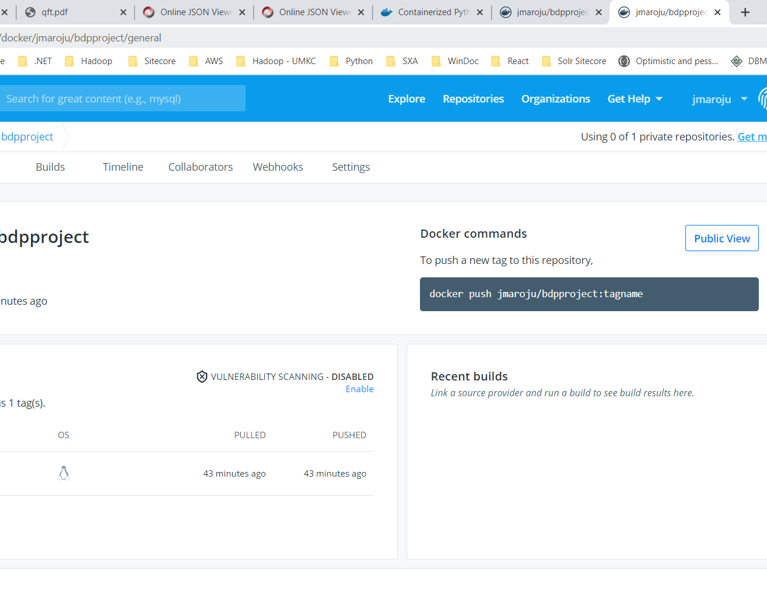
Docker
Finally, we have containerized in docker

Slide 22
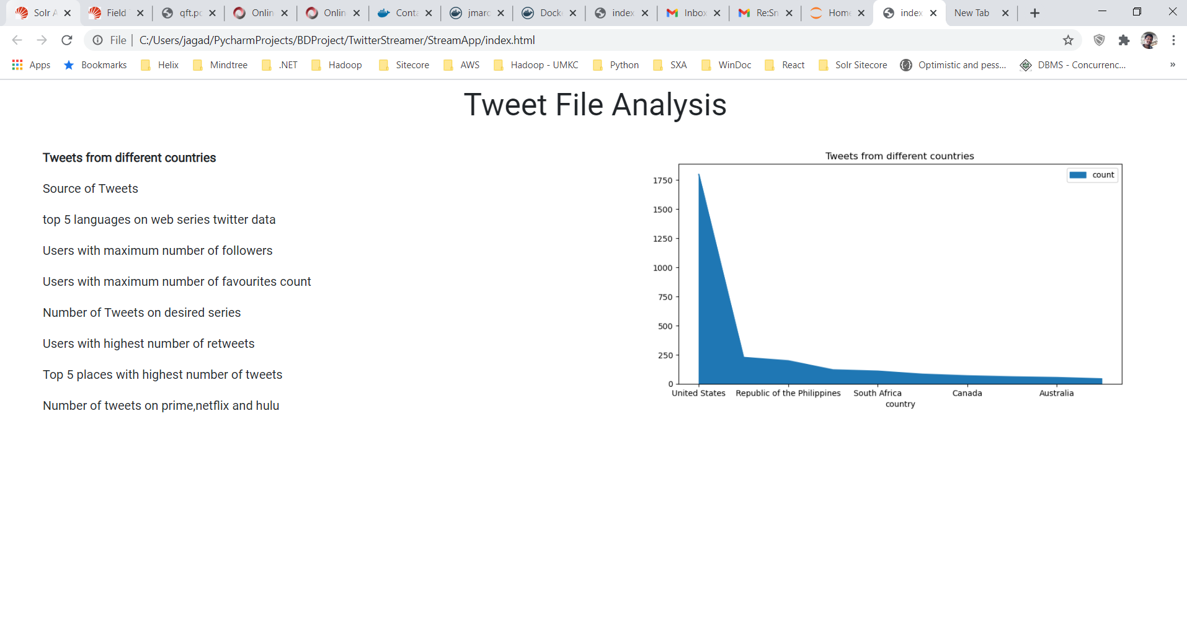
The Hosted site with the index.html page

Slide 23
APPLICATIONS
To draw out the collective results.
Understand most trending web series on social media.
Analyse positive and negative opinion of people on web series.

Slide 24
FUTURE WORK
Can use better Machine Learning Algorithm’s such as clustering, sentimental analysis
Try to stream the live data instead of collecting and parsing previous data from Twitter
Analyze more data sources such as Facebook, Reddit and not only depending on Twitter
Migrating to cloud fully without containerizing.

Slide 25
PROJECT MANAGEMENT
Done the ETL operations on the dataset and used spark streaming with scala by creating Dataframes and RDD’s with both scala and python programming (For initial increment - scala, for final report – python) it is observed that execution is much better in python compared to scala. Collected the dataset from twitter using tweepy and saved in json format. The tweet dataset is then converted into csv with data preprocessing to use and load it in solr. Applied algorithmic searches such as fuzzy and proximity in solr. And also loaded the data into hive table for query counts using different attributes/features. Used graphframes to find vertices, edges and indegree, outdegree, triangle count.
Finally created an index.html page for hosting it into the Docker container

Slide 26
TEAM RESPONSIBILITIES
Twitter data streaming (Avinash, Geetanjali)
Spark streaming using scala (Bhashitha, Avinash)
Spark streaming using python (Akhil, Geetanjali)
Convertion of json data to csv (Geetanjali, Bhashitha)
Solr execution (Akhil, Avinash)
Hive implementation (Avinash,Akhil)
Graphframes(Bhashitha, Avinash)
Index web page (Geetanjali,Avinash)
Dockerization (Akhil,Bhashitha)

Slide 27
iSSUES
Jdk version compatability between 15 and 8 for solr
As json data is large we faced difficult in loading the data to hive and solr
Converting json to csv is quite hectic because of the text filed
Faced difficulties with container in Docker.

Slide 28
STORY TELLING
 | WHO | WHAT | WHEN | WHERE | WHY
CHAPTER 1 | Helps the advertiser’s for pushing the advertisement and series makers for making quick analysis. | Pulling the data helps them in predicting the TRP which in result helps the series makers and advertisers. | As a result of COVID-19 most of the people settled back in their homes lacking entertainment. | All over the world. | Most of the people believe in IMDB rating rather than genre concept.

Slide 29
 | WHO | WHAT | WHEN | WHERE | WHY
CHAPTER 2 | The dataset is about the web series data where we sampled the tv shows, web series, Netflix series. The information disclosed about the shows watching around the world. Helps the advertiser’s for pushing the advertisement and series makers for making quick analysis. | The events like which show is being watched more an where it is being watched and which kind of people are watching are seen. It helps advertisers in pulling the data helps them in predicting the TRP which in result helps the series makers and advertisers. | The events take place on how people react to the series they tweet. As a result of COVID-19 most of the people settled back in their homes lacking entertainment. | All over the world. As everyone in the world haves an interest on web series and this data is being used everywhere. Thus, we are working on this data taking this into consideration. | Most of the people believe in IMDB rating rather than genre concept. That is the reason behind doing this web series data collection.

Slide 30
 | WHO | WHAT | WHEN | WHERE | WHY
CHAPTER 3 (Scientist and AI) | People who watch web series which make them feel comfortable. | Collected the data using python as json file which we visualized by various platform, Finally, hosted in docker. | Data of 2019 in all over the world collected with various hash tags related to web series of Netflix, prime, Hulu. | After getting the data. Later, Visualized the data using spark, solr, hive. Related to PB and BDP. | Helps to understanding the data by visualizing the data stream pulled from twitter.

Slide 31
 | WHO | WHAT | WHEN | WHERE | WHY
CHAPTER 4 (Users) | The set of people who are having free time and interested to watch the series can access the info. | Helps to Visualize the Data or impact of series on the current society based on various features/attributes. | Based on the Data available on the hosted index, user can get the contrast between the OTT platforms and the web series and their pulse among. | Deployed to docker and can host on EC2 instance. | Make’s aware of types of OTT platforms impact on the society.

Slide 32
 | WHO | WHAT | WHEN | WHERE | WHY
CHAPTER 5 (Society) | Users who are mostly spends their time on watching online series. Types of OTT platforms are sampled. No data is sampled. | This data which makes aware of the current situation about the OTT platforms, which mostly doesn’t have social or cultural impacts but only have idea about the OTT platforms. As the data grabbed from the twitter streaming will have security reasons. | If the tweets pulled based on the hashtags which web series related to region, caste, cultural can create positive or negative impact on the social or cultural but mostly it creates the negative impact which may breach the security. | Impact will be on the users who mostly rely on web series. If the Data collected concentrated on the particular set of webseries can cause the evaluative bias. | At current pandemic situation it will be consequential to people who are misled by the various paid platforms which give the review of the series.

Slide 33
CONCLUSION
Done the ETL process using the Spark’s Batch Processing and then Spark Integration using Web UI. Performed our transactions on the set of RDD’s and later we load our data in Hive which is similarly equal to the ETL basic process. This is because we are living in a world where data handling and data using plays one most important role in making the decisions for most of the industries. And at the present scenario where one has leisure time to binge watch series, where this web extraction and data analysis can be helpful.

Slide 34
References
developer.twitter.com/en/docs/tweets/data-dictionary/overview/intro-to-tweet-json
www.info.com/Twitter Data Visualization
spark.apache.org/docs/latest/
https://www.youtube.com/watch?v=lWzcZZEQYMk
https://docs.docker.com/docker-hub/publish/customer_faq/

Slide 35
THANK YOU

